Slide 1
ASCEP 平台介紹
林思涵
2020/05/21

Slide 2
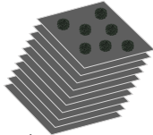
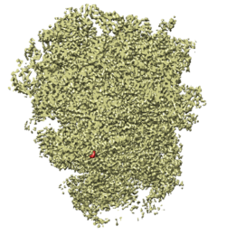
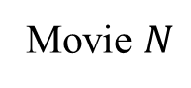
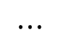
Cryo-EM Analysis Workflow
Movie 1
Movie 2
Movie 3
Movie $N$
Input：
$$⋯$$
Motion、CTF
Corrections
Particle Picking
2D Clustering
3D Reconstruction
Output：

Slide 3
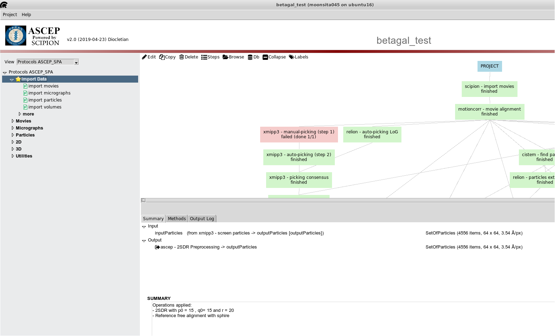

Slide 4
選擇模式

Slide 5
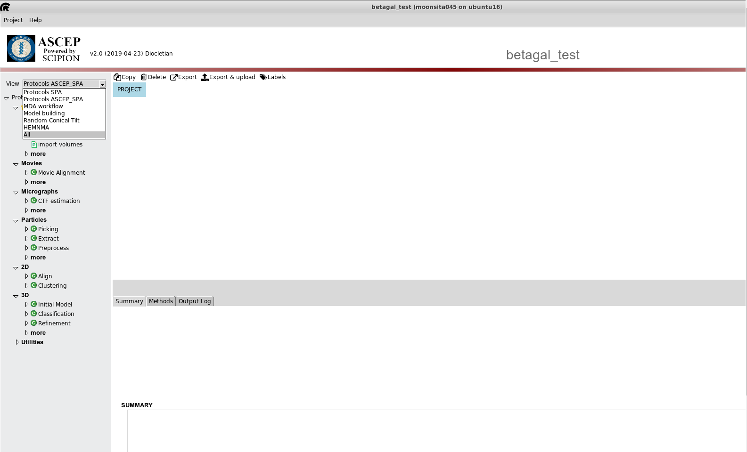
目前所有可以選擇的模式
Protocols ASCEP_SPA
此次要介紹的模式

Slide 6
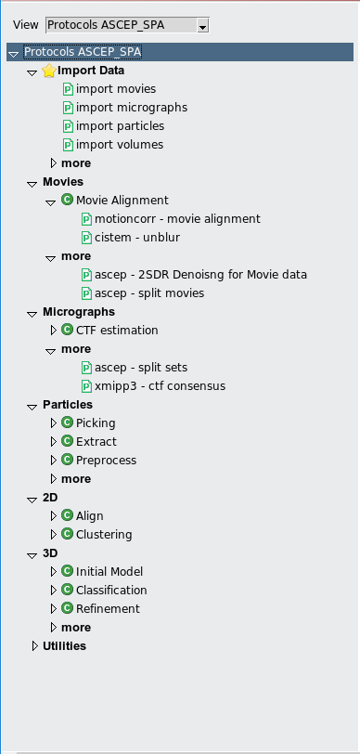
Movies
Motion correction
Micrographs
Particle Picking
CTF
Particles extract
Screen particles
Preprocess
2D clustering
Cleaned particle subset
Initial model
3D refinement

Slide 7
輸入資料

Slide 8
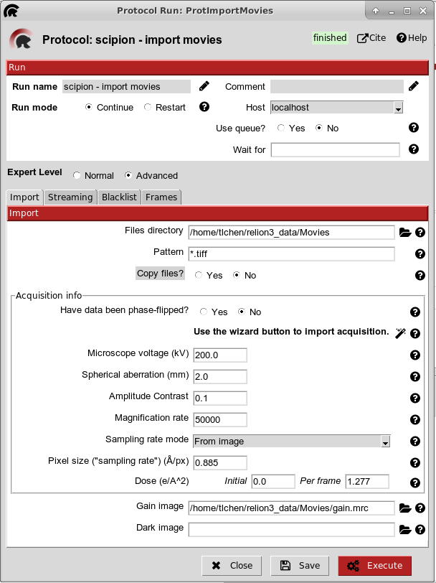
Movies
Motion correction
Micrographs
Particle Picking
CTF
Particles extract
Screen particles
Preprocess
2D clustering
Cleaned particle subset
Initial model
3D refinement

Slide 9
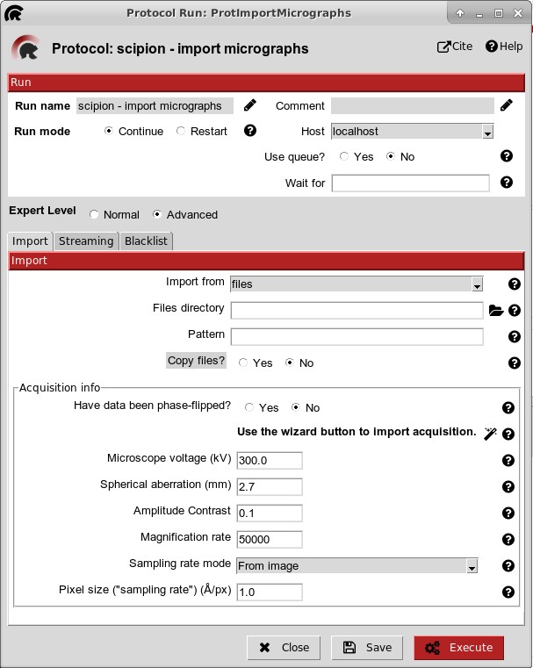
Movies
Motion correction
Micrographs
Particle Picking
CTF
Particles extract
Screen particles
Preprocess
2D clustering
Cleaned particle subset
Initial model
3D refinement

Slide 10
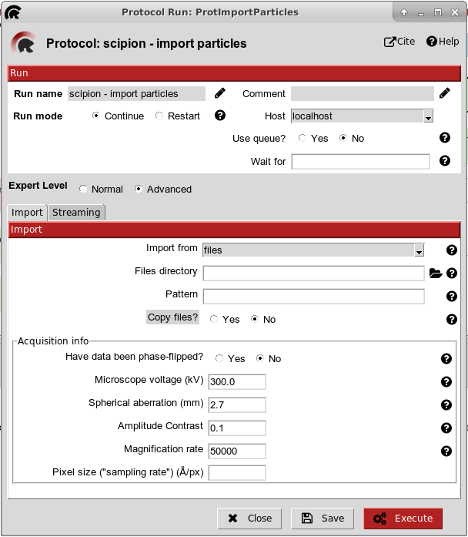
Movies
Motion correction
Micrographs
Particle Picking
CTF
Particles extract
Screen particles
Preprocess
2D clustering
Cleaned particle subset
Initial model
3D refinement

Slide 11
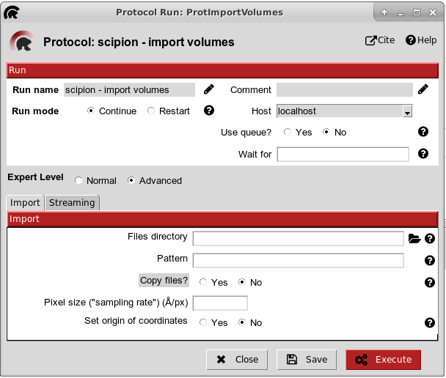
Movies
Movies
需要再輸入
particles資訊
Motion correction
Micrographs
Micrographs
Particle Picking
CTF
Particles extract
Particles extract
Screen particles
Preprocess
2D clustering
Cleaned particle subset
Initial model
3D refinement

Slide 12
資料前處理
Movies
Motion correction
Micrographs
Particle Picking
CTF
Particles extract
Screen particles
Preprocess
2D clustering
Cleaned particle subset
Initial model
3D refinement

Slide 13
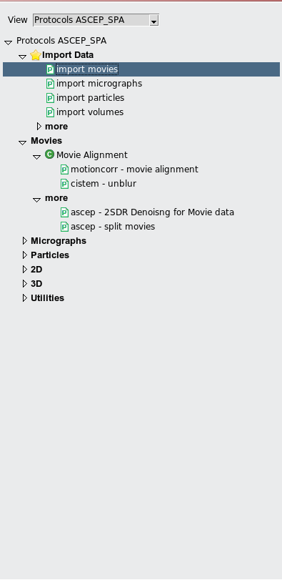
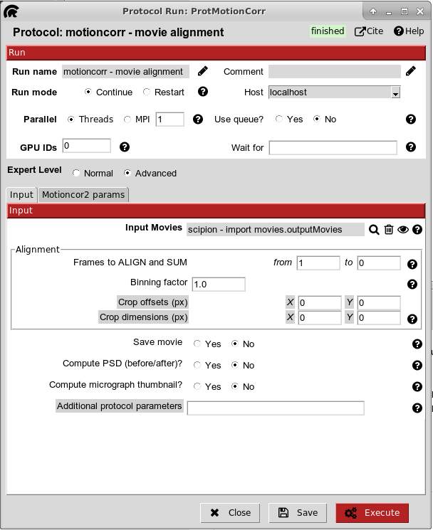
Movies
motioncorr-movie alignment
Motion correction
Micrographs
Particle Picking
CTF
Particles extract
Screen particles
Preprocess
方法一、motioncorr-movie alignment

Slide 14
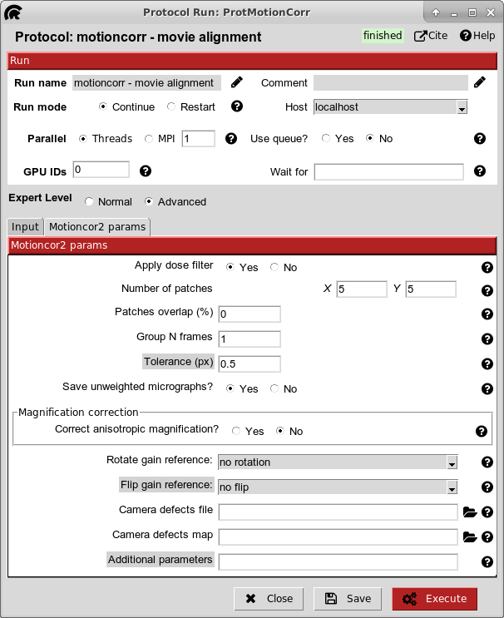
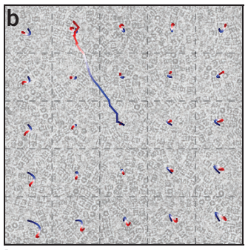
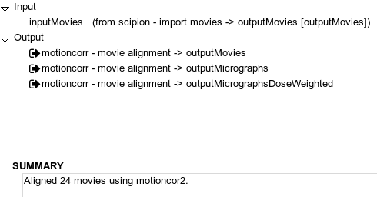
Movies
motioncorr-movie alignment
Motion correction
Micrographs
Particle Picking
CTF
Particles extract
Screen particles
Preprocess

Slide 15
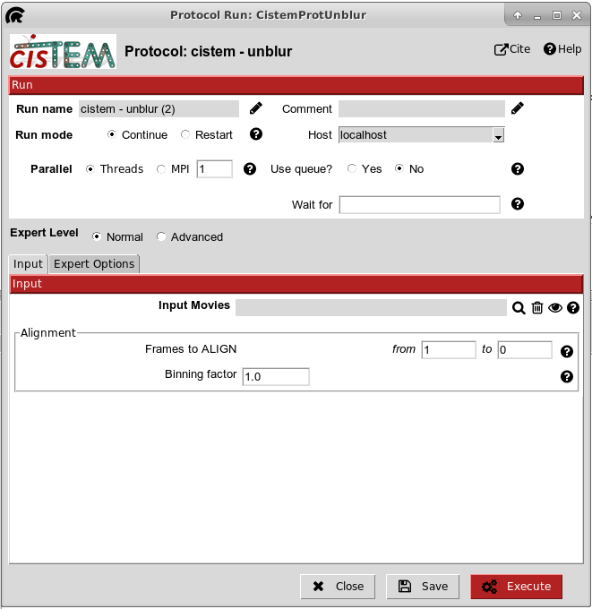
Movies
cistem-unblur
Motion correction
Micrographs
Particle Picking
CTF
Particles extract
Screen particles
Preprocess
方法二、cistem-unblur

Slide 16
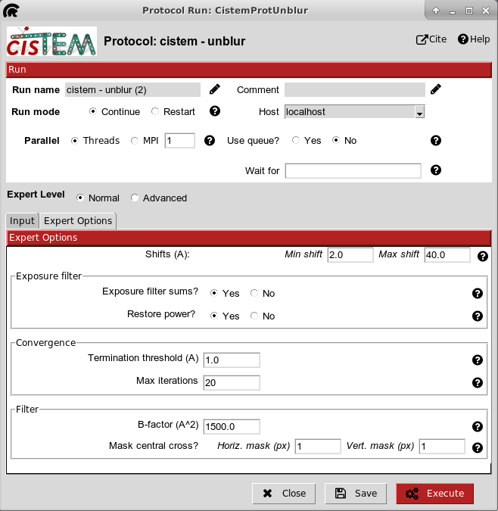
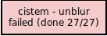
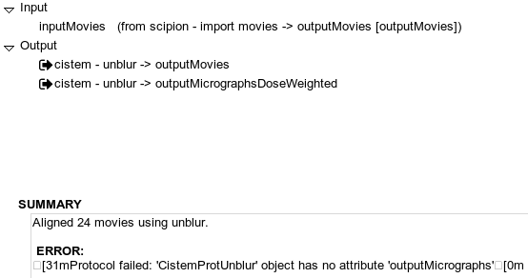
Movies
cistem-unblur
Motion correction
Micrographs
Particle Picking
CTF
Particles extract
Screen particles
Preprocess

Slide 17
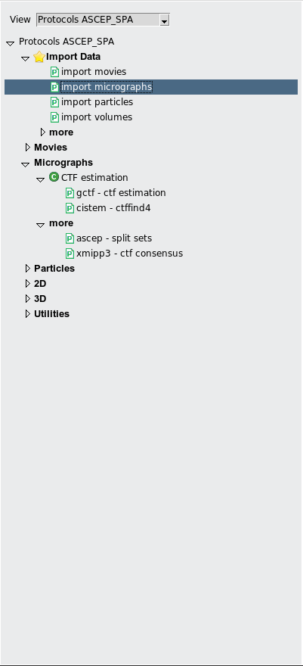
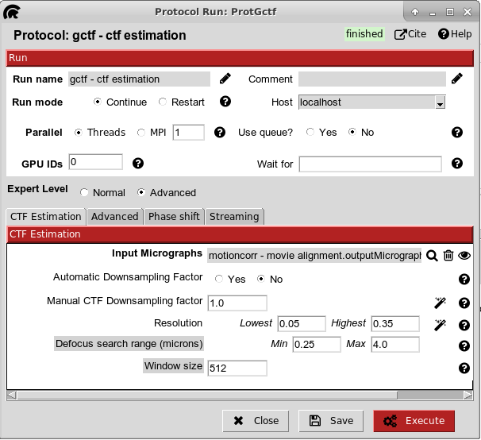
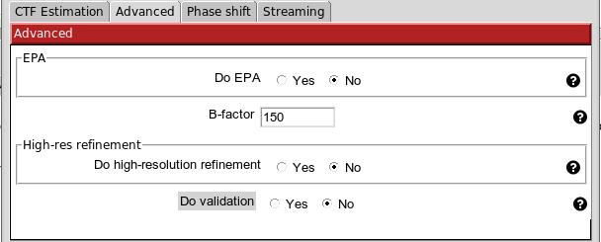
Movies
Motion correction
Micrographs
Particle Picking
CTF
Particles extract
Screen particles
Preprocess
方法一、gctf-ctf estimation

Slide 18
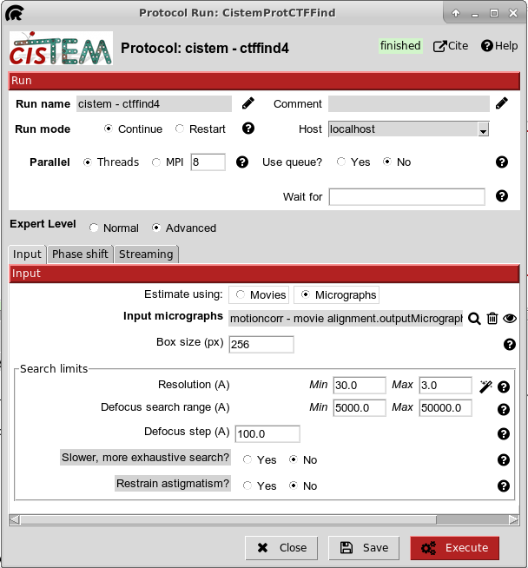
Movies
Motion correction
Micrographs
Particle Picking
CTF
Particles extract
Screen particles
Preprocess
方法二、cistem-ctffind4

Slide 19
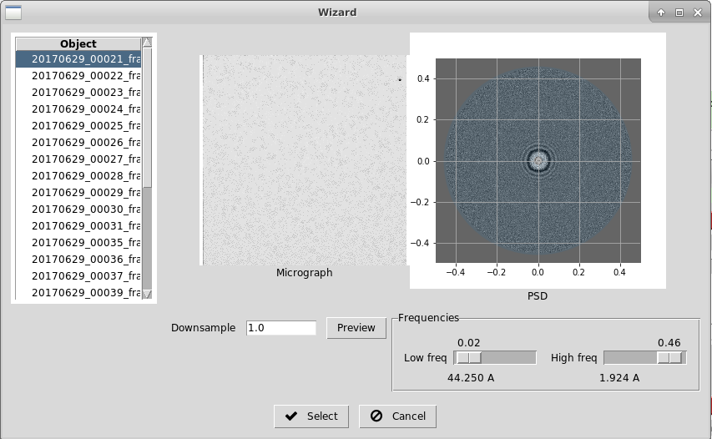
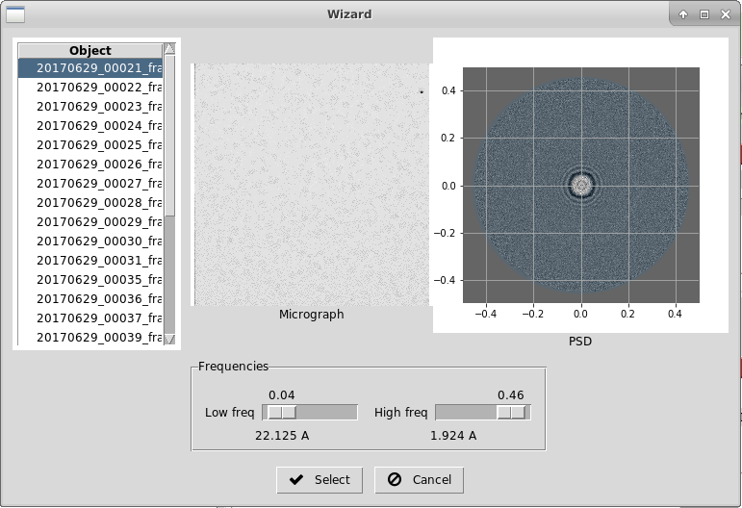
gctf-ctf estimation
cistem-ctffind4

Slide 20
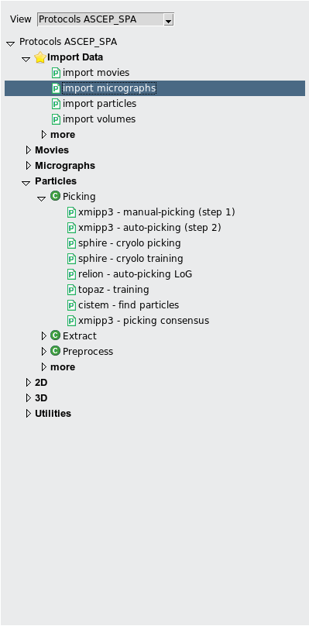
Movies
Motion correction
Micrographs
Particle Picking
CTF
Particle picking
收錄各種方法
Particles extract
xmipp
sphire
relion
topaz
cistem
Screen particles
Preprocess
xmipp3-picking consensus
(用於整合不同的particles picking)

Slide 21
Movies
Motion correction
Micrographs
Particle Picking
CTF
Particle picking
收錄各種方法
Particles extract
xmipp
sphire
relion
topaz
cistem
Screen particles
Preprocess
xmipp3-picking consensus
(用於整合不同的particles picking)

Slide 22
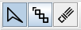
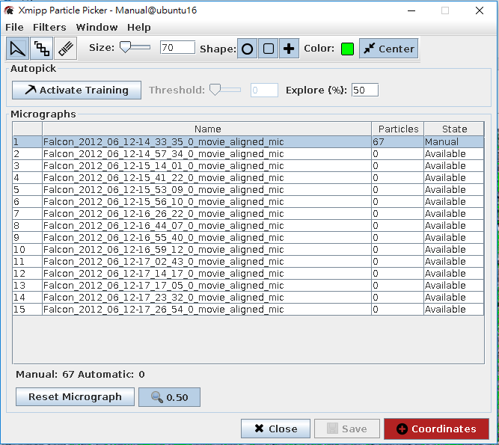
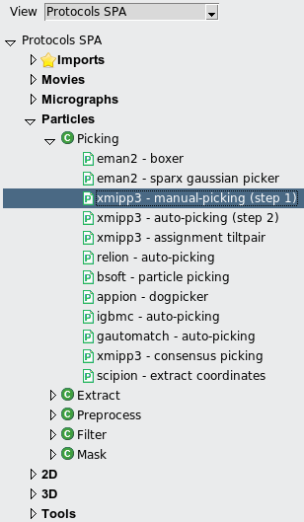
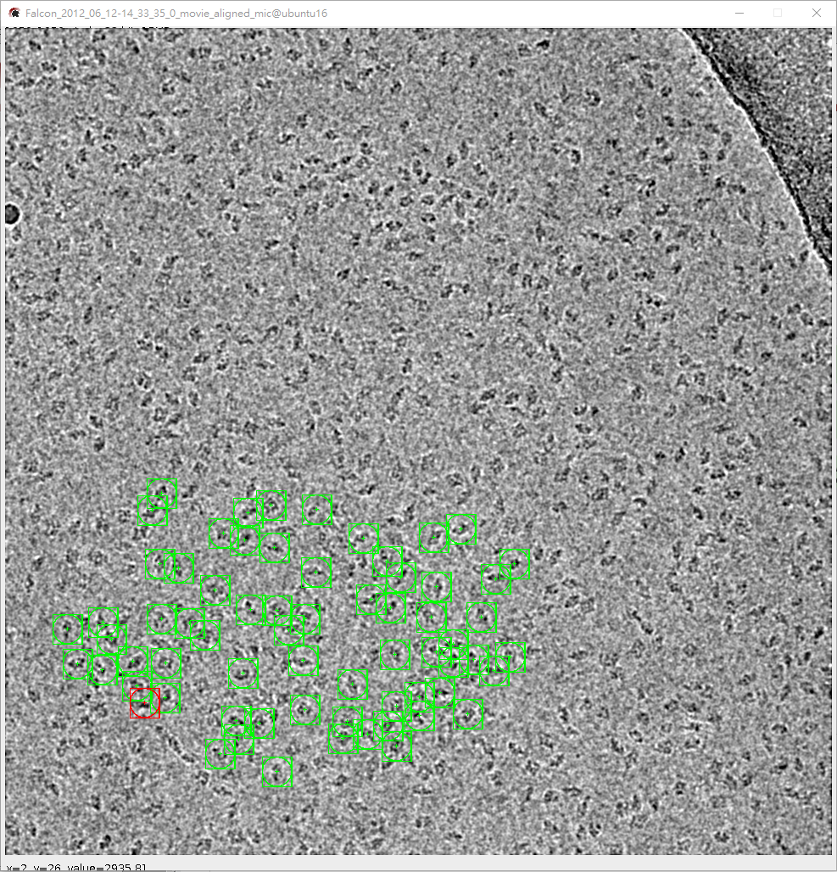
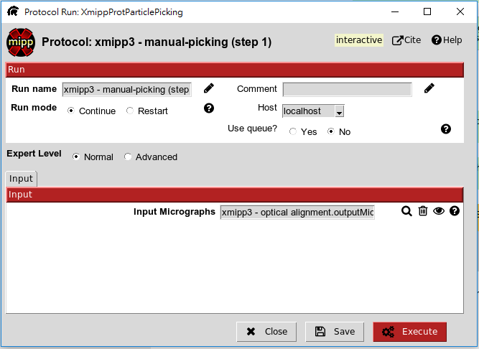
Particle picking
By 卉倫 手把手教學
圈選工具
4
調整框框size，可以先圈一個particle，再來回調整
圈particle 的標示
連續圈選，不好用
6
橡皮擦，用來刪除框框
圈了一些particle 在按這個按鈕
1
5
圈 particle
2
按 找到要輸入的資料
下一頁
3

Slide 23
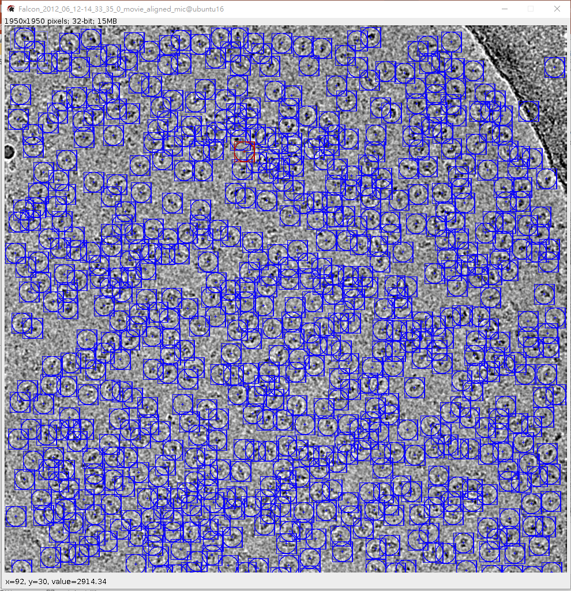
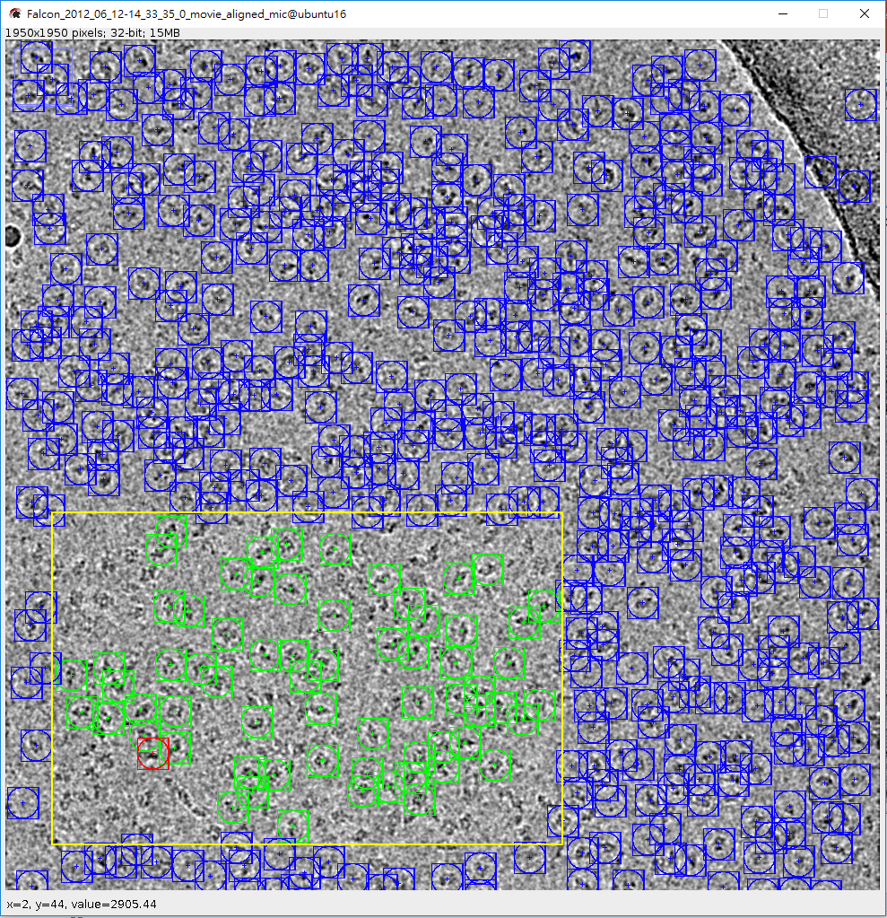

By 卉倫 手把手教學
第6步這個動作會讓程式自己圈選，但是可以看到黃色框框區域還有些沒選到
8
調整Threshod會影響最後particle選入的數量
9
在此只需做完一張 mircographs的 particle picking，其他張使用
Auto-picking
7
按下 Reset Micrographs 使之全部重選

Slide 24
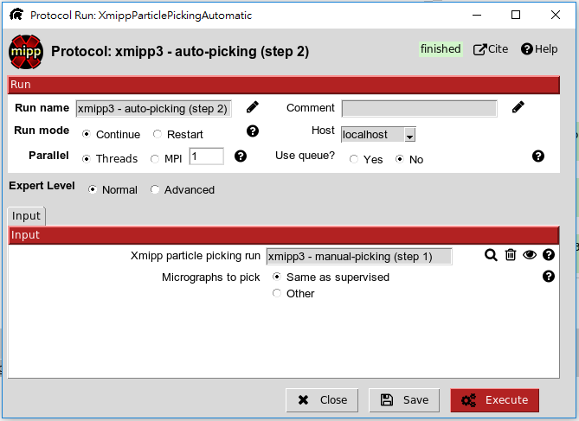
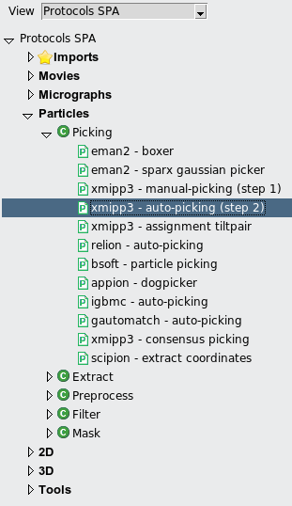
Auto-picking
By 卉倫 手把手教學
1
2
按 找到要輸入的資料
3

Slide 25
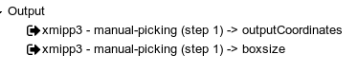
有關particle picking的要點
輸入：micrographs
參數：boxsize
輸出：particles在micrograph上的位置(Coordinates)

Slide 26
Movies
Motion correction
Micrographs
Particle Picking
CTF
Particle picking
收錄各種方法
Particles extract
xmipp
sphire
relion
topaz
cistem
Screen particles
Preprocess
xmipp3-picking consensus
(用於整合不同的particles picking)

Slide 27
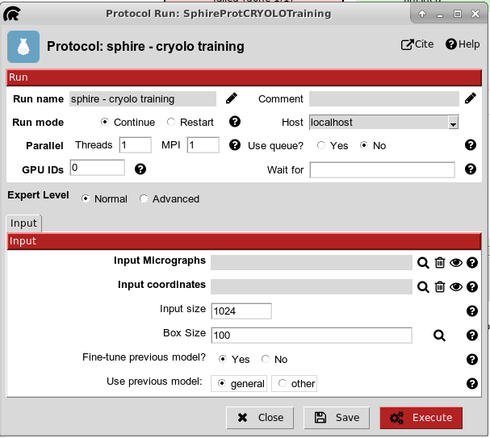
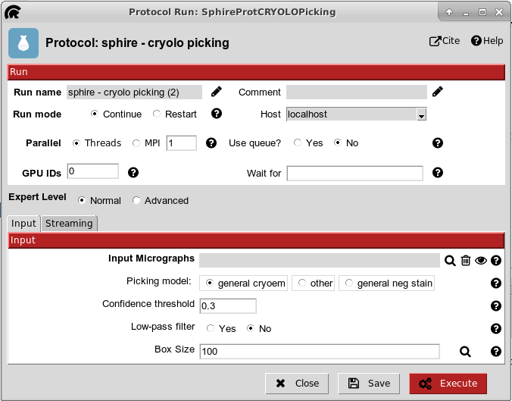
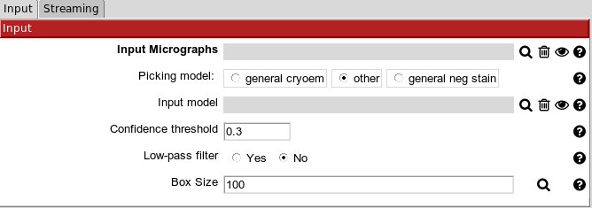
sphire
Step 1
Step 2

Slide 28
Movies
Motion correction
Micrographs
Particle Picking
CTF
Particle picking
收錄各種方法
Particles extract
xmipp
sphire
relion
topaz
cistem
Screen particles
Preprocess
xmipp3-picking consensus
(用於整合不同的particles picking)

Slide 29
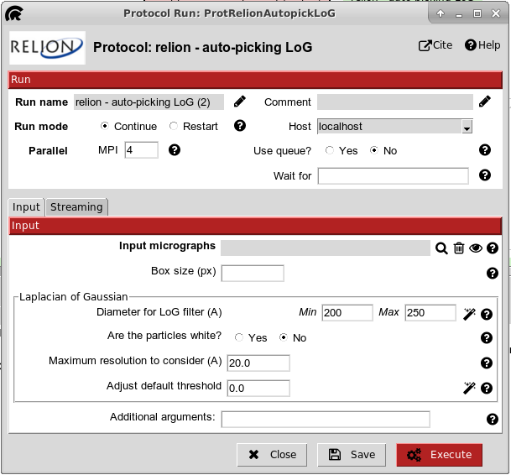

Slide 30
Movies
Motion correction
Micrographs
Particle Picking
CTF
Particle picking
收錄各種方法
Particles extract
xmipp
sphire
relion
topaz
cistem
Screen particles
Preprocess
xmipp3-picking consensus
(用於整合不同的particles picking)

Slide 31
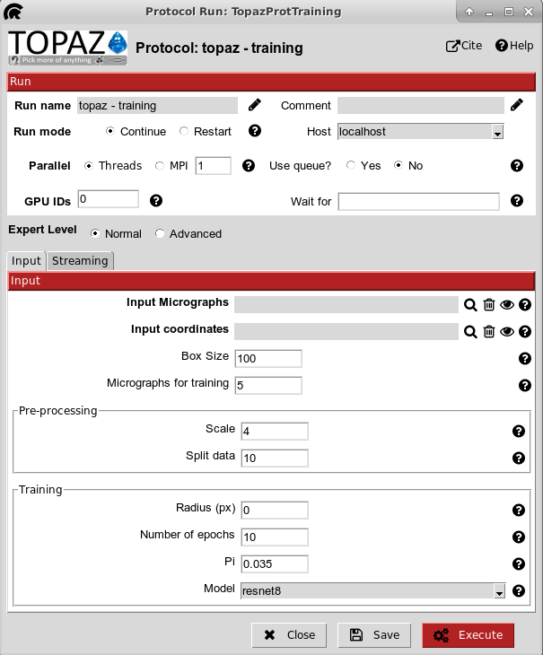
與sphire不一樣的地方是
同時包含了training與picking

Slide 32
Movies
Motion correction
Micrographs
Particle Picking
CTF
Particle picking
收錄各種方法
Particles extract
xmipp
sphire
relion
topaz
cistem
Screen particles
Preprocess
xmipp3-picking consensus
(用於整合不同的particles picking)

Slide 33
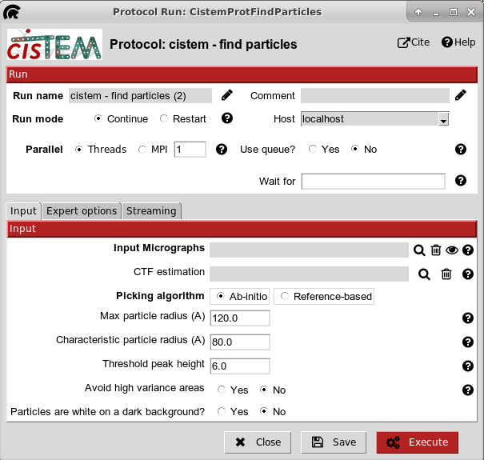
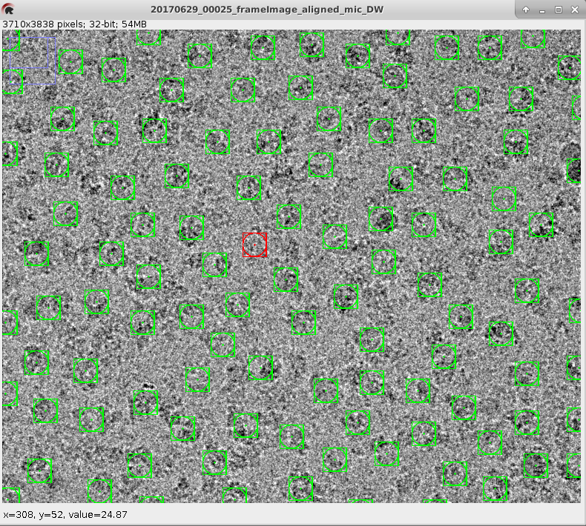
輸出particles中心所在位置
沒有boxsize
boxsize留至particles extract再設定

Slide 34
整合數種不同的particles picking

Slide 35
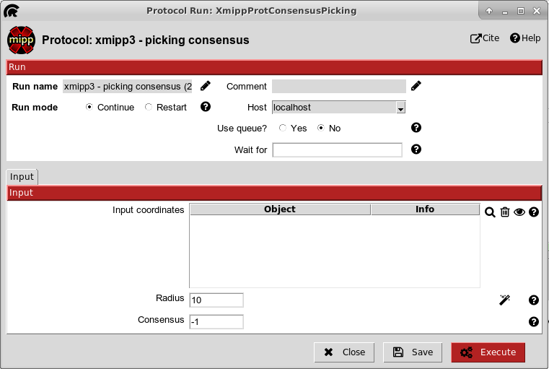
在設定距離內，不同方法所選取到的particle，視作同一顆particle
-1：表示不同方法要選種同一顆，才挑選該particle
1：不同方法挑選的particle都算

Slide 36
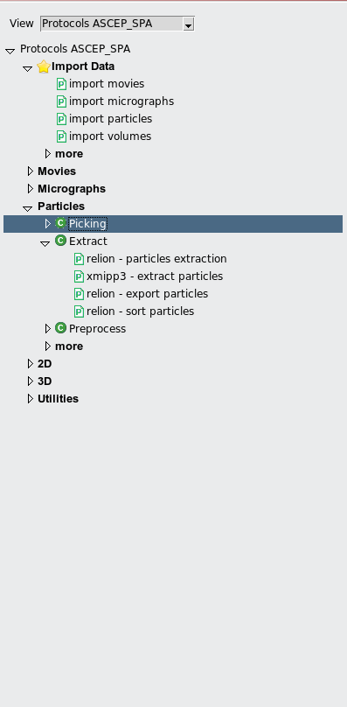
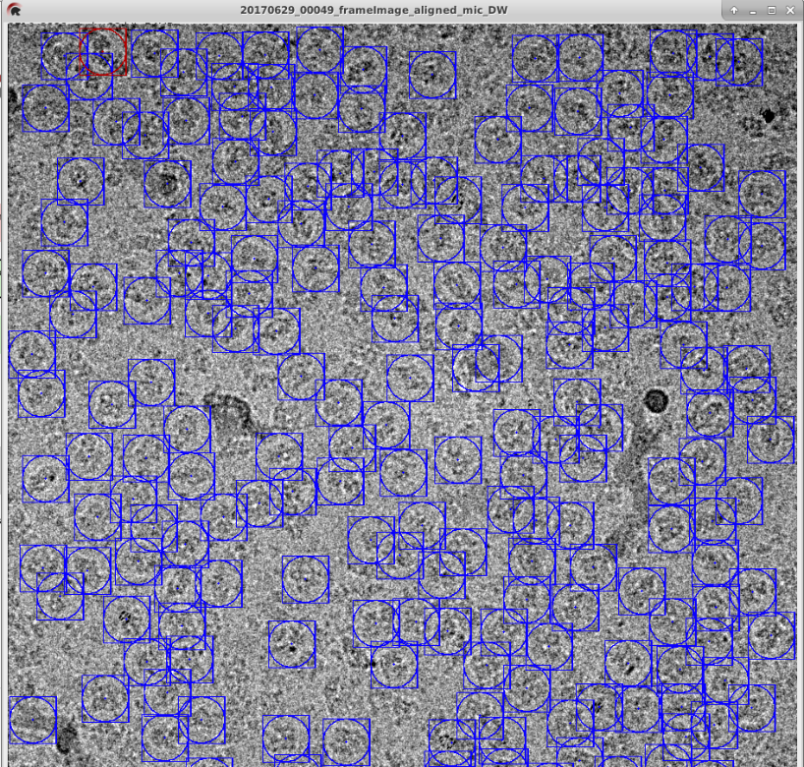
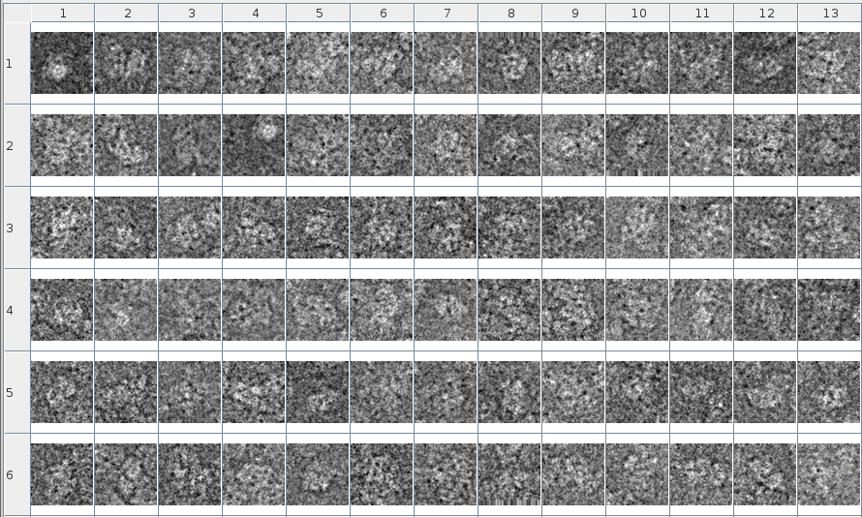
Movies
Picking
Motion correction
Micrographs
Particle Picking
CTF
Particles extract
Screen particles
Preprocess
Extract

Slide 37
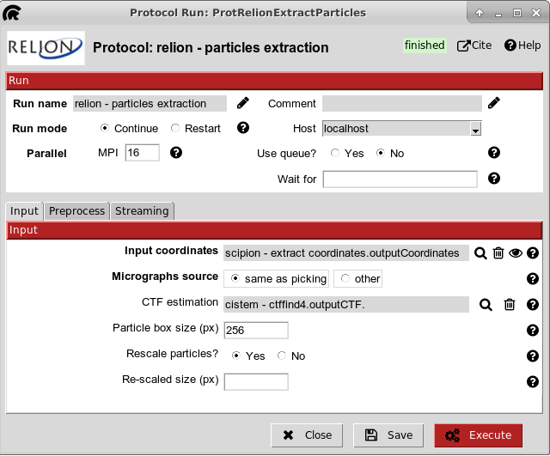
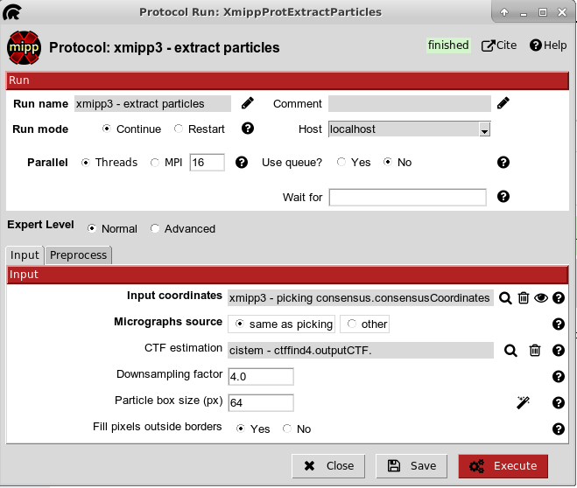
relion
xmipp3
如果遇到資料量太大，可以將資料downsampling
舉例來說：
原來的box size為256
Downsampling factor為4
降低後的bos size為64

Slide 38


Movies
Motion correction
Micrographs
Particle Picking
CTF
Particles extract
Screen particles
Preprocess

Slide 39


Movies
relion
Motion correction
Micrographs
Particle Picking
CTF
Particles extract
Screen particles
Preprocess
Particle images normalize

Slide 40


Movies
2SDR
Motion correction
Micrographs
Particle Picking
CTF
Particles extract
Screen particles
Preprocess
先粗略的把所有particles轉至相同方向

Slide 41
Cryo-EM Analysis
Movies
Motion correction
Micrographs
Particle Picking
CTF
Particles extract
Screen particles
Preprocess
2D clustering
Cleaned particle subset
Initial model
3D refinement

Slide 42





Preprocess
2D clustering
Cleaned particle subset
Initial model
3D refinement

Slide 43


Preprocessing
Denoising
Denoising可以得到清楚的輪廓

Slide 44




Preprocess
2D clustering
Cleaned particle subset
Initial model
3D refinement

Slide 45





Preprocess
2D clustering
Cleaned particle subset
Initial model
3D refinement

Slide 46

Preprocess
2D clustering
Cleaned particle subset
Initial model
3D refinement

Slide 47


Preprocess
2D clustering
Cleaned particle subset
Initial model
3D refinement

Slide 48


Preprocess
2D clustering
Cleaned particle subset
Initial model
3D refinement

Slide 49

Preprocess
2D clustering
Cleaned particle subset
Initial model
3D refinement
例子
(以ISAC為例子)
紅圈即為選中的
Cleaned particle subset
看3D initial model需要哪種

Slide 50




Preprocess
2D clustering
Cleaned particle subset
Initial model
3D refinement
particles

Slide 51

Preprocess
2D clustering
Cleaned particle subset
Initial model
3D refinement
classes

Slide 52






Preprocess
2D clustering
Cleaned particle subset
Initial model
3D refinement
需要特別選擇

Slide 53

Preprocess
2D clustering
Cleaned particle subset
Initial model
如果一開始不確定Symmetry的類型
選擇C1
這些模型類型通用於不同方法
3D refinement

Slide 54



Preprocess
2D clustering
Cleaned particle subset
Initial model
3D refinement

Slide 55

Preprocess
2D clustering
Cleaned particle subset
如何判斷做完homogeneous後，
還需要再做non-uniform?
Initial model
3D refinement

Slide 56
The End

